Slide 1
Android开机关机系列
深圳框架组
2022.3
杜国伟
duguowei@xiaomi.com

Slide 2
内容和目标
内容
本文涉及到非平台相关的开机、关机流程
涵盖到开、关机过程中重要的进程
重启、死机、 APEX、ROLLBACK等相关场景
基于当前Android12平台，以及L11的matisse项目等
目标
能够熟悉开机流程、关机流程
能够掌握开关机过程中重要的进程启动相关
能够对开关机相关的问题进行定位和分析

Slide 3
Android开关机
开机流程
正常开机
recovery
关机充电
安全模式
rollback模式
关键进程
关机流程
重启方法
CRASH分析
PANIC分析

Slide 4
Android开关机
开机流程
正常开机
关机充电
recovery
安全模式
关键进程
init
vold
audioserver
installd
adbd
zygote64 zygote
surfaceflinger
lmkd
system_server
...
关机流程
重启方法
CRASH
PANIC

Slide 5
Android开机流程
平台相关
高通
MTK
bootloader（LK）
linux kernel
init
daemon
android framework
APK

Slide 6
Android开机流程 LK
平台相关
高通
pbl
sbl
MTK
bootloader（LK）
splash.img
load dtbo.img
load kernel
normal
recovery
poweroff charge
// Don't mount filesystems or start core system services in charger mode.

Slide 7
Android开机流程 LK
bootloader
bootable/lk/...
bootable/recovery
wipe_userdata等相关的流程
updata.zip
...
bootable/recovery/minui
recovery模式下基本的图形相关的API

Slide 8
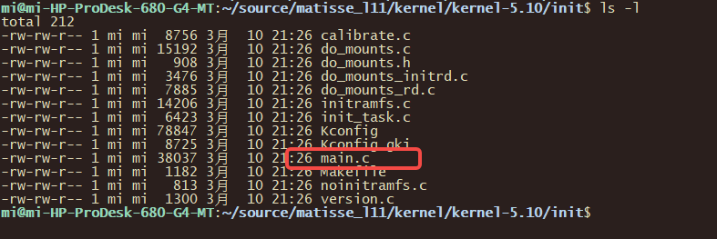
Android开机流程 KERNEL
start_kernel

Slide 9
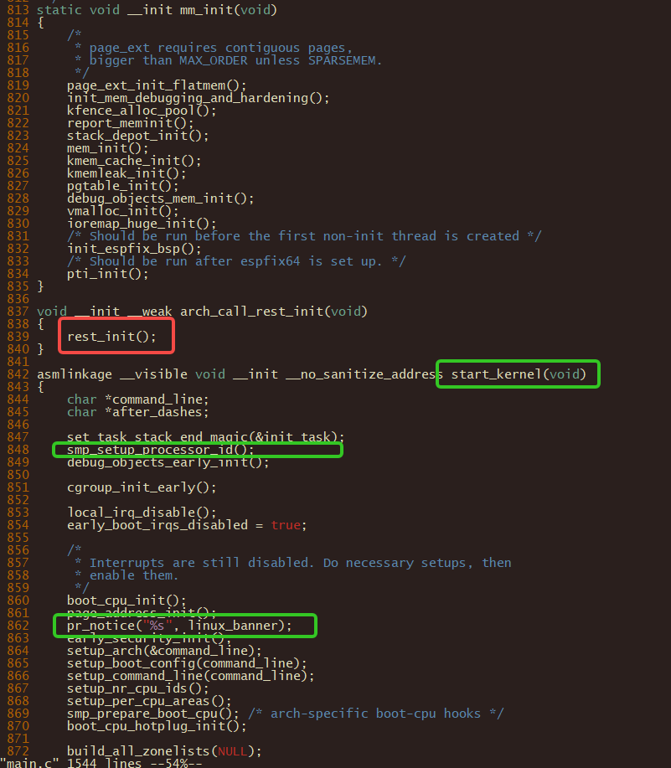

Android开机流程 kernel
<6>[ 0.000000][ T0] swapper: [name:setup&]Booting Linux on physical CPU 0x0000000000 [0x410fd462]
<5>[ 0.000000][ T0] swapper: [name:main&]Linux version 5.10.66-android12-9-g9bd3ed4ca07d (build-user@build-host) (Android (7284624, based on r416183b) clang version 12.0.5 (https://android.googlesource.com/toolchain/llvm-project c935d99d7cf2016289302412d708641d52d2f7ee), LLD 12.0.5 (/buildbot/src/android/llvm-toolchain/out/llvm-project/lld c935d99d7cf2016289302412d708641d52d2f7ee)) #1 SMP PREEMPT Wed Mar 2 15:19:15 UTC 2022
红色图中

Slide 10
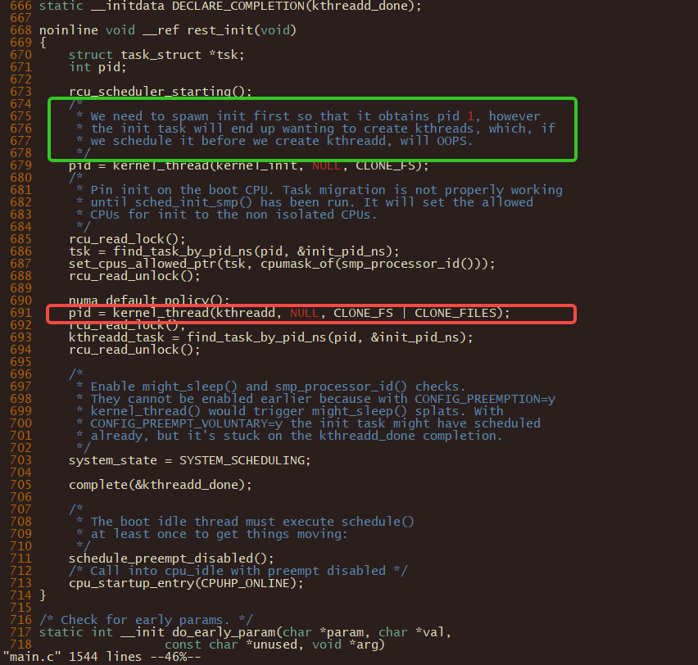
Android开机流程 kernel
rest_init
init
kthreadd
while(true)

Slide 11
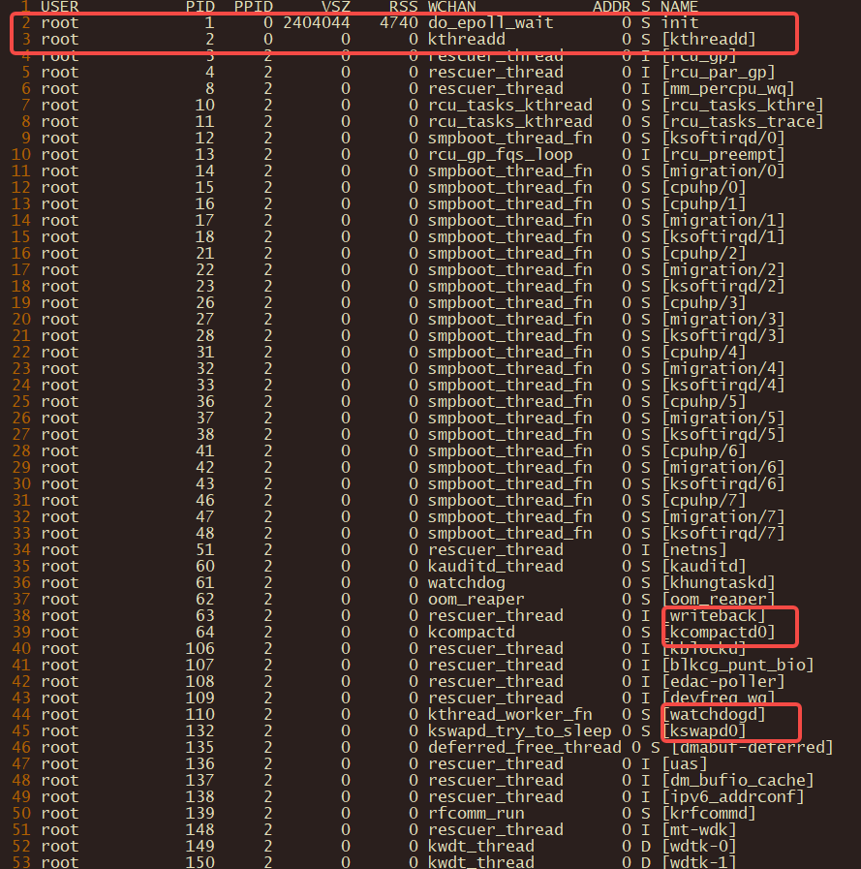
Android开机流程 init
init
1号进程
用户空间大总管
kthreadd
2号进程
内核空间大总管

Slide 12
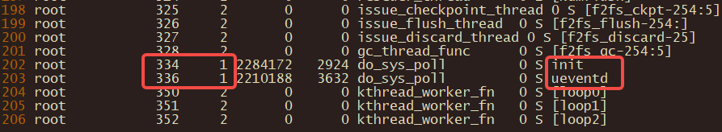
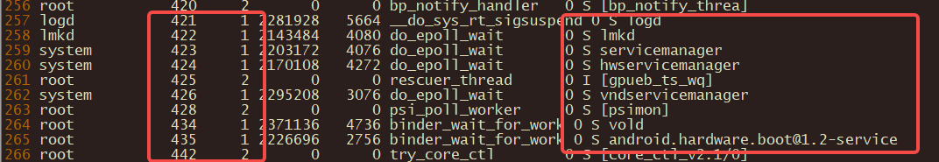
Android开机流程 init
init

Slide 13
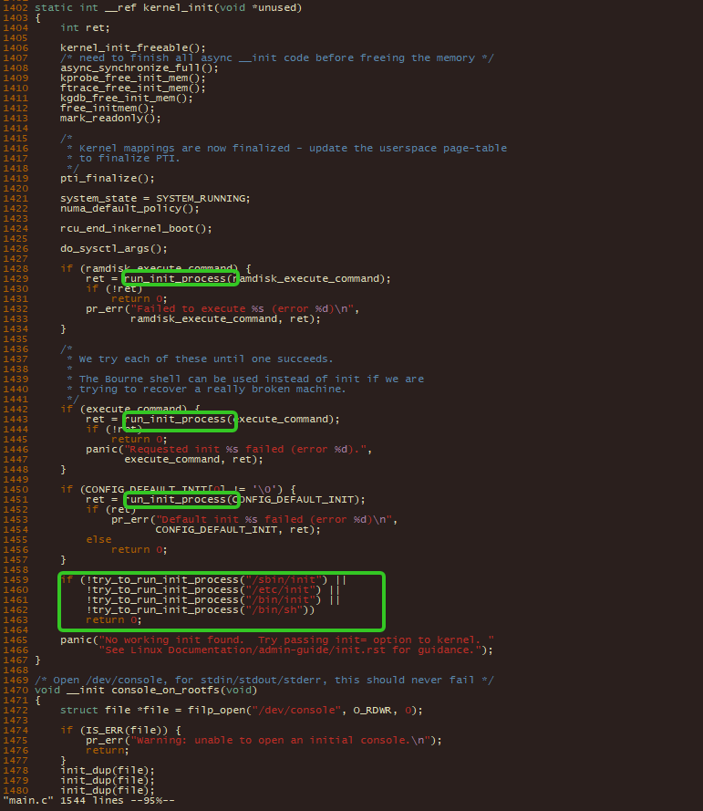
Android开机流程 init
kernel_init
ramdisk_execute_command = “/init”;
initrd=
execute_command
init=
X
DEFAULT_INIT
“”
X
try_to_run_init_process
X

Slide 14
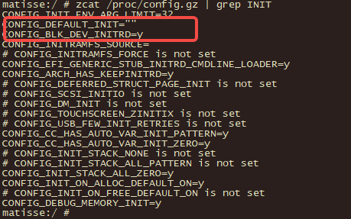
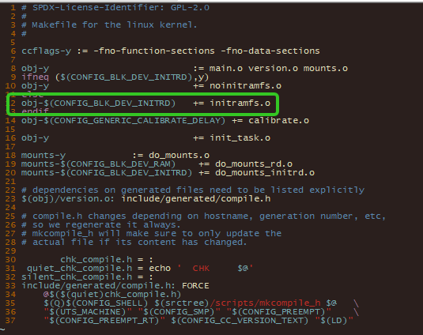
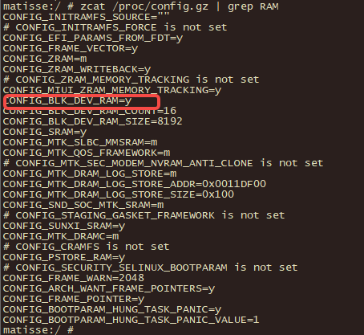
Android开机流程 init
init

Slide 15
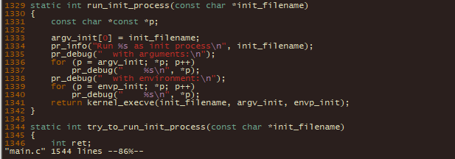
Android开机流程 init
<6>[ 1.005706][T700001] swapper/0: [name:main&]Run /init as init process
<7>[ 1.005713][T700001] swapper/0: [name:main&] with arguments:
<7>[ 1.005715][T700001] swapper/0: [name:main&] /init
<7>[ 1.005717][T700001] swapper/0: [name:main&] bootconfig
<7>[ 1.005719][T700001] swapper/0: [name:main&] with environment:
<7>[ 1.005720][T700001] swapper/0: [name:main&] HOME=/
<7>[ 1.005722][T700001] swapper/0: [name:main&] TERM=linux
<7>[ 1.005724][T700001] swapper/0: [name:main&] usb2jtag_mode=0
<14>[ 1.006982][T700001] init: init 3: init first stage started!

Slide 16
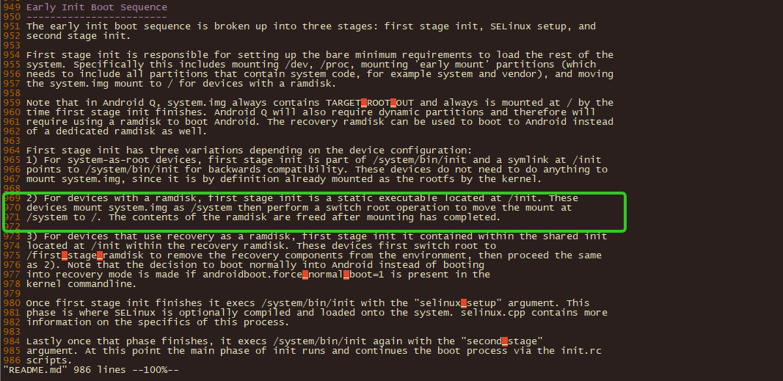
Android开机流程 init
2

Slide 17
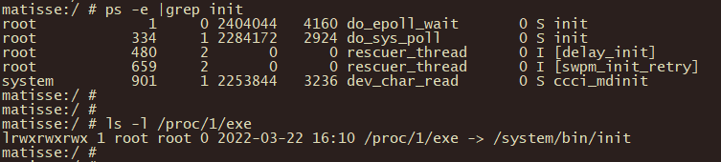
Android开机流程 init
1号进程
不能被KILL
first_stage
<14>[ 1.006982][T700001] init: init 3: init first stage started!
secondstage
<14>[ 3.838646][T700001] init: init 3: init second stage started!

Slide 18
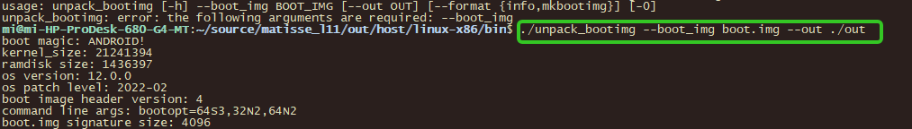
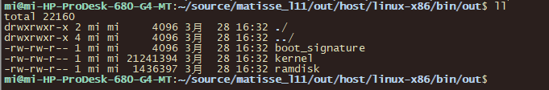
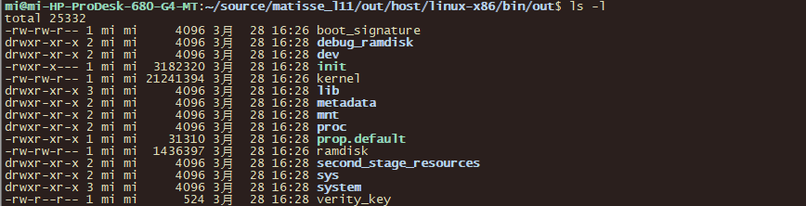
Android开机流程 init
ramdisk/init(boot.img vendor_boot.img)

Slide 19
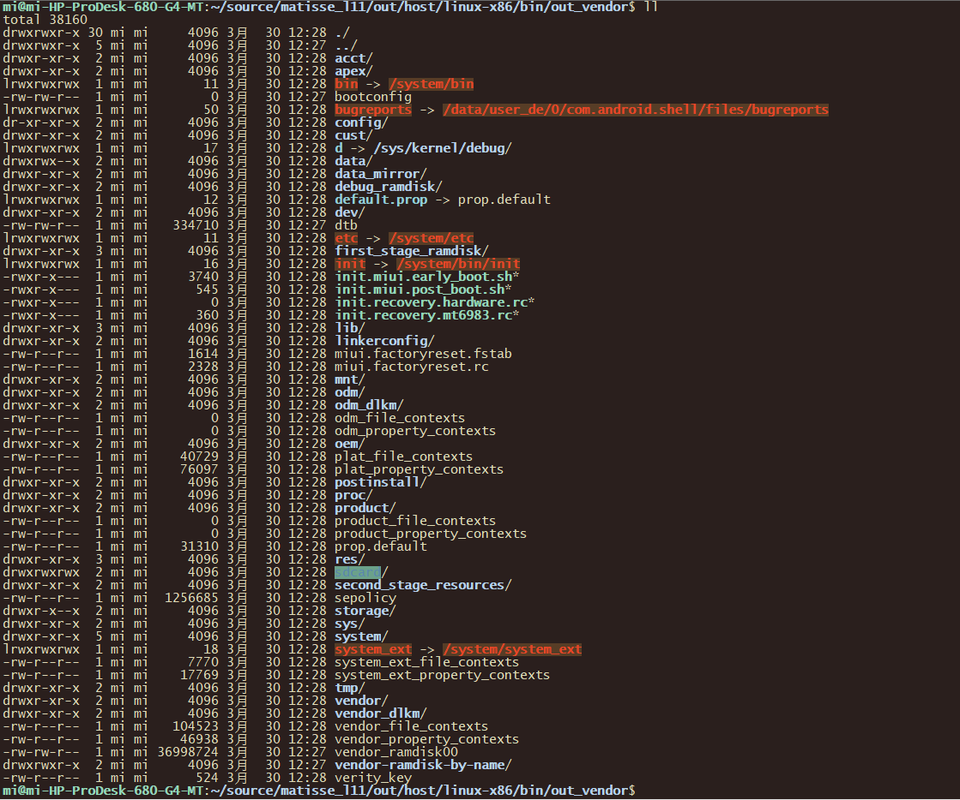
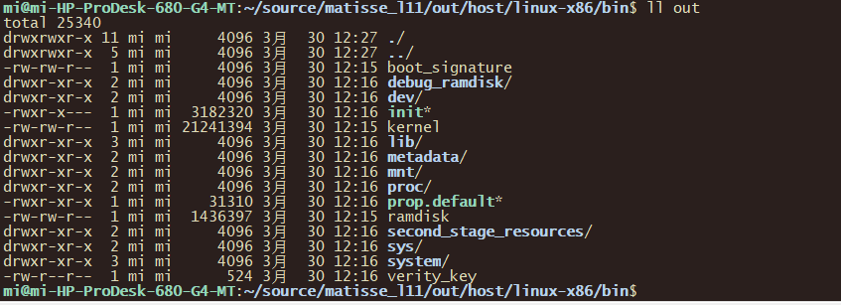
Android开机流程 init ramdisk
boot/ramdisk
vendor_boot/ramdisk

Slide 20
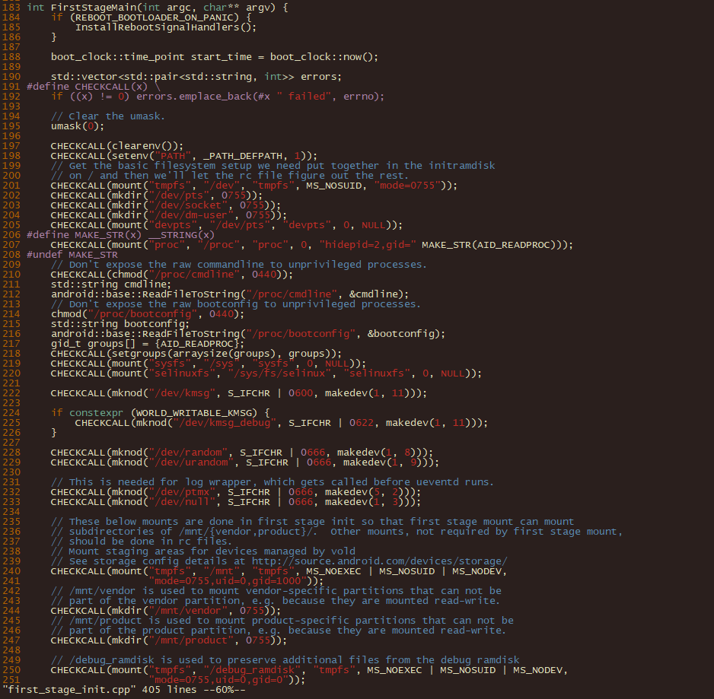
Android开机流程 init first_stage
first_stage

Slide 21
Android开机流程 init first_stage
<14>[ 1.008676][T700001] init: init 3: Loading module /lib/modules/mkp.ko with args ''
<14>[ 3.159444][T700001] init: init 6: Loaded kernel module /lib/modules/simtray.ko
<14>[ 3.159611][T700001] init: init 6: Loaded 180 kernel modules took 2152 ms
<14>[ 3.159693][T700001] init: init 6: Copied ramdisk prop to /second_stage_resources/system/etc/ramdisk/build.prop
mkdir("/first_stage_ramdisk", 0755);
SwitchRoot("/first_stage_ramdisk");
<14>[ 3.159781][T700001] init: init 6: Switching root to '/first_stage_ramdisk'
<14>[ 3.159935][T700001] init: init 6: [libfs_mgr]ReadFstabFromDt(): failed to read fstab from dt
<14>[ 3.160205][T700001] init: init 6: Using Android DT directory /proc/device-tree/firmware/android/
前面提到的vendor_boot.img中ramdisk:
first_stge_ramdisk/fstab.mt6983
/lib/modules-->early-init

Slide 22
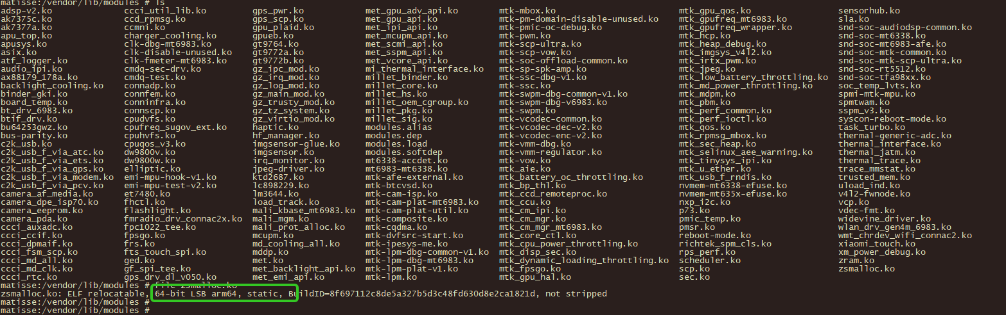
Android开机流程 init first_stage
/vendor/lib/modules/
insmod

Slide 23
Android开机流程 init first_stage
<14>[ 3.219179][T300001] init: init 7: [libfs_mgr]__mount(source=/dev/block/by-name/metadata,target=/metadata,type=ext4)=0: Success
<14>[ 3.229028][T300001] init: init 7: [libfs_mgr]__mount(source=/dev/block/dm-2,target=/system,type=erofs)=0: Success
<14>[ 3.229213][T300001] init: init 7: Switching root to '/system‘
<14>[ 3.230772][T300001] init: init 7: [libfs_mgr]__mount(source=/dev/block/dm-4,target=/vendor,type=erofs)=0: Success
<14>[ 3.231363][T300001] init: init 7: [libfs_mgr]__mount(source=/dev/block/dm-1,target=/product,type=erofs)=0: Success
<14>[ 3.231907][T300001] init: init 7: [libfs_mgr]__mount(source=/dev/block/dm-0,target=/odm,type=erofs)=0: Success
<4>[ 3.621548][T400001] init: printk: [name:printk&]init: 3 output lines suppressed due to ratelimiting
<14>[ 3.636396][T400001] init: init 9: [libfs_mgr]__mount(source=overlay,target=/system,type=overlay,upperdir=/mnt/scratch/overlay/system/upper)=0
<14>[ 3.637353][T400001] init: init 9: [libfs_mgr]__mount(source=overlay,target=/vendor,type=overlay,upperdir=/mnt/scratch/overlay/vendor/upper)=0
<14>[ 3.637997][T400001] init: init 9: [libfs_mgr]__mount(source=overlay,target=/product,type=overlay,upperdir=/mnt/scratch/overlay/product/upper)=0
<14>[ 3.638657][T400001] init: init 9: [libfs_mgr]__mount(source=overlay,target=/odm,type=overlay,upperdir=/mnt/scratch/overlay/odm/upper)=0
<14>[ 3.697319][T600001] init: init 4: Opening SELinux policy
<14>[ 3.700426][T600001] init: init 4: Loading SELinux policy

Slide 24
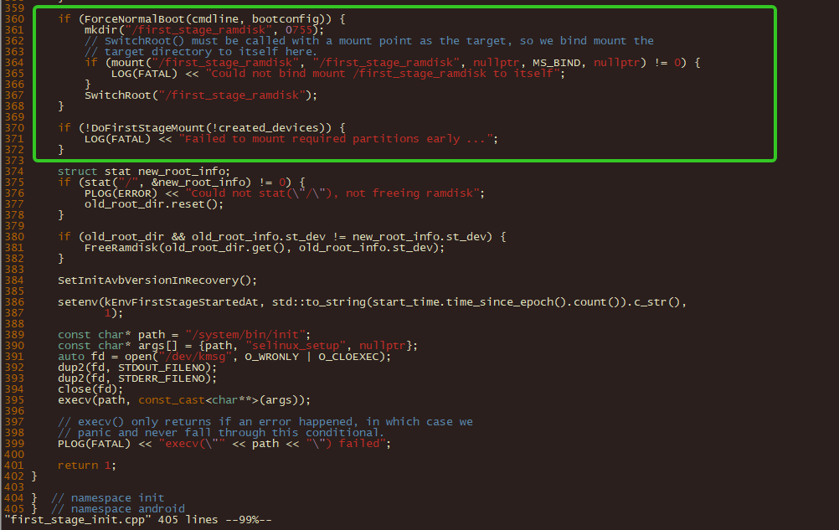
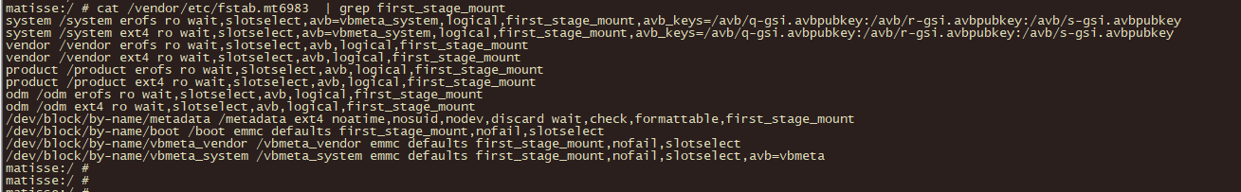
Android开机流程 init first_stage
mkdir("/first_stage_ramdisk", 0755);
SwitchRoot("/first_stage_ramdisk");
fastab ramdisk vendor
vendor_boot
first_stage_rmdisk/fstab.mt6983

Slide 25
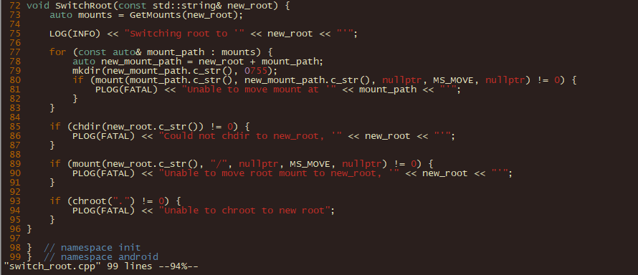
Android开机流程 init first_stage
537 bool FirstStageMount::MountPartitions() {
505 // If system is in the fstab then we're not a system-as-root device, and in
506 // this case, we mount system first then pivot to it. From that point on,
507 // we are effectively identical to a system-as-root device.
508 bool FirstStageMount::TrySwitchSystemAsRoot() {
if (MountPartition(system_partition, false /* erase_same_mounts */)) {
SwitchRoot("/system");

Slide 26
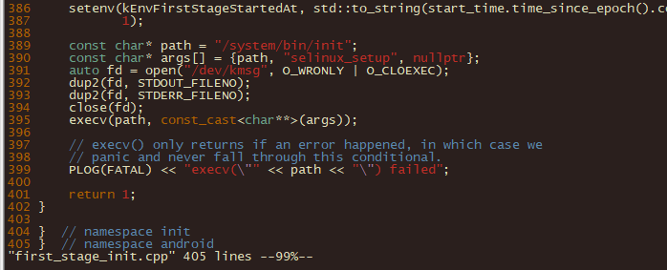
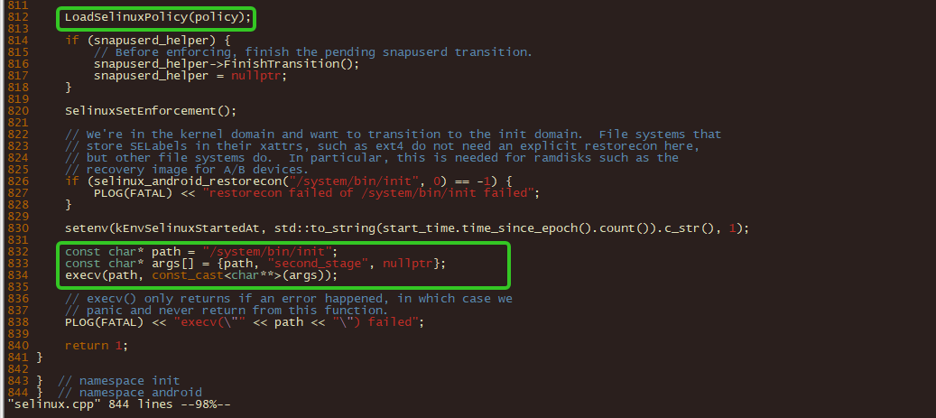
Android开机流程 init first_stage
<14>[ 3.697319][T600001] init: init 4: Opening SELinux policy
<14>[ 3.700426][T600001] init: init 4: Loading SELinux policy
<14>[ 3.830003][T700001] init: selinux 4: SELinux: Loaded file_contexts

Slide 27
Android开机流程 init second_stage
<14>[ 3.838646][T700001] init: init 3: init second stage started!
mount("tmpfs", "/apex", "tmpfs", MS_NOEXEC | MS_NOSUID | MS_NODEV,"mode=0755,uid=0,gid=0"));
mount("tmpfs", "/linkerconfig", "tmpfs", MS_NOEXEC | MS_NOSUID | MS_NODEV,"mode=0755,uid=0,gid=0"));
<14>[ 3.860534][T700001] init: selinux 6: SELinux: Loaded file_contexts
<14>[ 3.860539][T700001] init: init 6: Running restorecon...
/dev
/apex
/linkerconfig
...

Slide 28
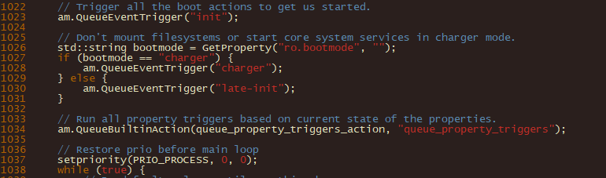
Android开机流程 init second_stage
int SecondStageMain(int argc, char** argv) {
early-init
init
late-init/charger
所谓的关机充电，实际kernel已经开启
也可以将关机充电放到kernel之前做，但涉及到图形方面比较麻烦
// Don't mount filesystems or start core system services in charger mode.
while(true)
init进入main loop

Slide 29
Android开机流程 init second_stage
early-init
start ueventd
exec_start apexd-bootstrap
apexd动态开启（后面章节会讲到）
init
chown/write /mnt /proc /sys
start lmkd/start servicemanager/start hwservicemanager/start vndservicemanager
late-init
trigger early-fs
trigger fs
trigger post-fs
trigger post-fs-data
trigger load_persist_props_action
trigger zygote-start
trigger early-boot
trigger boot

Slide 30
Android开机流程 init second_stage
early-init
start ueventd
exec_start apexd-bootstrap
apexd动态开启

Slide 31
Android开机流程 init second_stage
<11>[ 3.871190][T700001] init: init 6: ----duguowei make_dir---/mnt/user
<11>[ 3.871320][T700001] init: init 6: ----duguowei make_dir---/mnt/userrc=0
<11>[ 3.871330][T700001] init: init 6: ----duguowei make_dir---/mnt/installer
<11>[ 3.871543][T700001] init: init 19: ----duguowei make_dir---/mnt/installerrc=0
<11>[ 3.871548][T700001] init: init 19: ----duguowei make_dir---/mnt/androidwritable
<11>[ 3.871588][T700001] init: init 19: ----duguowei make_dir---/mnt/androidwritablerc=0
<14>[ 3.872046][T700001] init: init 19: Forked subcontext for 'u:r:vendor_init:s0' with pid 336
<14>[ 3.872378][T700001] init: init 19: Parsing file /system/etc/init/hw/init.rc...
<14>[ 3.872676][T700001] init: init 19: Added '/init.environ.rc' to import list
<14>[ 3.872681][T700001] init: init 19: Added '/system/etc/init/hw/init.usb.rc' to import list
<14>[ 3.872687][T700001] init: init 19: Added '/init.mt6983.rc' to import list
<14>[ 3.872696][T700001] init: init 22: Added '/vendor/etc/init/hw/init.mt6983.rc' to import list
<14>[ 3.872699][T700001] init: init 22: Added '/system/etc/init/hw/init.usb.configfs.rc' to import list
<14>[ 3.872704][T700001] init: init 22: Added '/system/etc/init/hw/init.zygote64_32.rc' to import list
<14>[ 3.872707][T700001] init: init 22: Added '/init.miui.rc' to import list
<14>[ 3.873111][T700001] init: init 22: Parsing file /init.environ.rc...
...

Slide 32
Android开机流程 init second_stage
<14>[ 3.901328][T400001] init: init 19: [3875][0]processing action (early-init) from (/system/etc/init/hw/init.rc:18)
<14>[ 3.903499][T400001] init: init 19: [3877][0]starting service 'exec 1 (/system/bin/bootstrap/linkerconfig --target /linkerconfig/bootstrap)'...
<14>[ 3.904562][T400001] init: init 19: [3877][0]SVC_EXEC service 'exec 1 (/system/bin/bootstrap/linkerconfig --target /linkerconfig/bootstrap)' pid 337 (uid 0 gid 0+0 context default) started; waiting...
<14>[ 3.915860][T400001] init: init 19: [3890][11]Service 'exec 1 (/system/bin/bootstrap/linkerconfig --target /linkerconfig/bootstrap)' (pid 337) exited with status 0 waiting took 0.011000 seconds
<14>[ 3.916821][T400001] init: init 22: [3890][0]starting service 'ueventd'...
<14>[ 3.918524][T400001] init: init 22: [3892][0]starting service 'apexd-bootstrap'...
<14>[ 3.919881][T700334] init: init 4: [3894][0]ReapLogC PropSet [ro.boottime.init]=[981001000]3844 [ro.boottime.init.first_stage]=[2688330077]3844 [ro.boottime.init.selinux]=[143622538]3844 [ro.boottime.init.modules]=[2152]3844 [ro.boot.avb_version]=[1.2]3845 [ro.boot.flash.locked]=[0]3845 [sys.usb.controller]=[dummy_udc.0]3845 [ro.gsid.image_running]=[0]3872 [gsid.image_installed]=[0]3872 [dev.mnt.blk.metadata]=[sdc]3874 [dev.mnt.blk.root]=[dm-2]3875 [dev.mnt.blk.vendor]=[dm-4]3875 [dev.mnt.blk.product]=[dm-1]3875 [dev.mnt.blk.odm]=[dm-0]3875 [dev.mnt.blk.mnt.scratch]=[dm-5]3875 [sys.init.perf_lsm_hooks]=[1]3875 [init.svc.ueventd]=[running]3892 [ro.boottime.ueventd]=[3891851769]3892 [init.svc_debug_pid.ueventd]=[338]3892 [init.svc.apexd-bootstrap]=[running]3894 [ro.boottime.apexd-bootstrap]=[3893653230]3894 Done
<14>[ 3.920040][T400001] init: init 22: [3892][0]SVC_EXEC service 'apexd-bootstrap' pid 339 (uid 0 gid 1000+0 context default) started; waiting...
<14>[ 3.939472][T600339] apexd: apexd: Bootstrap subcommand detected
<14>[ 3.939506][T400338] ueventd: ueventd: ueventd started!
<14>[ 3.940812][T400338] ueventd: selinux: SELinux: Loaded file_contexts
<14>[ 3.940817][T400338] ueventd: selinux:
<14>[ 3.941163][T700338] ueventd: ueventd: Parsing file /system/etc/ueventd.rc...
<14>[ 3.941223][T700338] ueventd: ueventd: Added '/vendor/etc/ueventd.rc' to import list
<14>[ 3.941235][T700338] ueventd: ueventd: Added '/odm/etc/ueventd.rc' to import list
<14>[ 3.941588][T700338] ueventd: ueventd: Parsing file /vendor/etc/ueventd.rc...
<14>[ 3.942016][T700338] ueventd: ueventd: Parsing file /odm/etc/ueventd.rc...
<14>[ 3.942031][T700338] ueventd: ueventd: Unable to read config file '/odm/etc/ueventd.rc': open() failed: No such file or directory
<14>[ 3.942048][T700338] ueventd: ueventd: Parsing file /vendor/ueventd.rc...

Slide 33
Android开机流程 init apexd-bootstrap
<14>[ 4.195035][T500339] apexd: apexd: wait for '/dev/loop-control' took 246ms
<14>[ 4.198717][T500339] apexd: apexd: Pre-allocated 15 loopback devices
<14>[ 4.198755][T500339] apexd: apexd: Scanning /system/apex for pre-installed ApexFiles
<14>[ 4.198816][T500339] apexd: apexd: Found pre-installed APEX /system/apex/com.android.adbd.capex
<14>[ 4.202269][T200339] apexd: apexd: Found pre-installed APEX /system/apex/com.android.apex.cts.shim.apex
<14>[ 4.202540][T200339] apexd: apexd: Found pre-installed APEX /system/apex/com.android.appsearch.apex
<14>[ 4.202765][T200339] apexd: apexd: Found pre-installed APEX /system/apex/com.android.art.capex
<14>[ 4.204202][T200339] apexd: apexd: Found pre-installed APEX /system/apex/com.android.conscrypt.apex
<14>[ 4.204418][T200339] apexd: apexd: Found pre-installed APEX /system/apex/com.android.extservices.gms.capex
<6>[ 4.216890][T500351] apexd: EXT4-fs (loop0): mounted filesystem without journal. Opts: (null)
apex_payload.img: Linux rev 1.0 ext2 filesystem data, UUID=7d1522e1-9dfa-5edb-a43e-98e3a4d20250 (extents) (large files) (huge files)
<6>[ 4.218580][T500350] apexd: EXT4-fs (loop3): mounted filesystem without journal. Opts: (null)
<6>[ 4.220578][T200349] apexd: EXT4-fs (loop1): mounted filesystem without journal. Opts: (null)
<6>[ 4.220802][ T348] apexd: EXT4-fs (loop2): mounted filesystem without journal. Opts: (null)
<4>[ 4.224352][T600339] apexd: printk: [name:printk&]apexd: 34 output lines suppressed due to ratelimiting
<14>[ 4.224433][T500001] init: init 22: [4198][2]Service 'apexd-bootstrap' (pid 339) exited with status 0 waiting took 0.305000 seconds
<14>[ 4.224441][T500001] init: init 22: [4198][2]Sending signal 9 to service 'apexd-bootstrap' (pid 339) process group...
<14>[ 4.224521][T500001] init: libprocessgroup 22: [4198][2]Successfully killed process cgroup uid 0 pid 339 in 0ms

Slide 34
Android开机流程 init /vendor/lib..
<14>[ 4.398839][T600001] init: init 23: [4370][0]starting service 'insmod_sh'...
/vendor/bin/init.insmod.sh
/vendor/lib/modules/modules.load

Slide 35
Android开机流程 init second_stage
late-init
trigger early-fs
start vold ---# Once metadata has been mounted, we'll need vold to deal with userdata checkpointing
trigger fs
mount_all --early
trigger post-fs
trigger post-fs-data
chown system system /data(# We chown/chmod /data again so because mount is run as root + defaults)
chmod 0771 /data
restorecon /data(# We restorecon /data in case the userdata partition has been reset.)
mkdir /data/...
trigger load_persist_props_action
start logd
trigger zygote-start
trigger early-boot
installd
trigger boot
class_start hal
class_start core

Slide 36
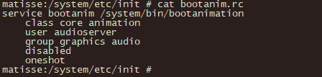
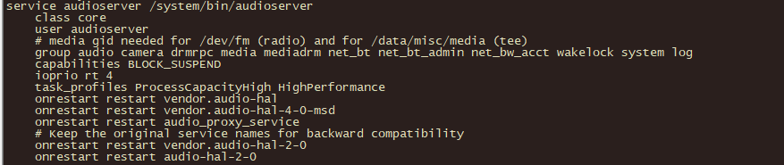
Android开机流程 init zygote
<14>[ 7.319914][T500001] init: init 28: [7293][64]processing action (ro.crypto.state=encrypted && ro.crypto.type=file && zygote-start) from (/system/etc/init/hw/init.rc:991)
start zygote(class main)
start zygote_secondary
<14>[ 7.341411][T600001] init: init 28: [7315][0]processing action (zygote-start) from (/vendor/etc/init/hw/init.mt6983.rc:784)
early-boot
boot
class_start hal(# Start standard binderized HAL daemons)
class_start core
/system/bin/ueventd
/system/bin/sh
bootanimation
audioserver
…

Slide 37
Android开机流程 zygote
<14>[ 7.338174][T600001] init: init 29: [7312][0]starting service ‘zygote’...(64位)
<14>[ 7.338344][T600001] init: init 29: [7312][0]Created socket '/dev/socket/zygote', mode 660, user 0, group 1000
<14>[ 7.339860][T600001] init: init 29: [7314][0]starting service ‘zygote_secondary’...（32位）
<14>[ 7.340009][T600001] init: init 28: [7314][0]Created socket '/dev/socket/zygote_secondary', mode 660, user 0, group 1000
<14>[ 7.486036][T600001] init: init 30: [7460][0]processing action (zygote-start) from (/vendor/etc/init/hw/init.mt6983.rc:784)
<6>[ 7.486274][T600334] init: [name:bootprof&]BOOTPROF: 7486.270863:INIT:zygote-start
<14>[ 7.486368][T600001] init: init 30: [7460][0]processing action (firmware_mounts_complete) from (/system/etc/init/hw/init.rc:482)
<14>[ 7.486419][T600001] init: init 30: [7460][0]processing action (early-boot) from (/vendor/etc/init/hw/init.mt6983.rc:787)
<6>[ 7.486556][T600334] init: [name:bootprof&]BOOTPROF: 7486.552709:INIT:early-boot
<14>[ 7.487165][T600001] init: init 30: [7461][0]processing action (early-boot) from (/system/etc/init/installd.rc:5)

Slide 38
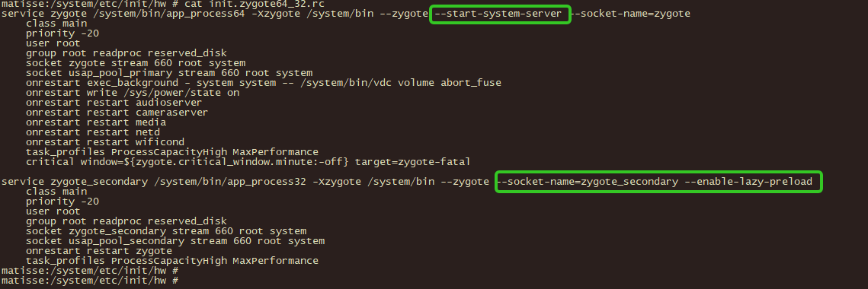
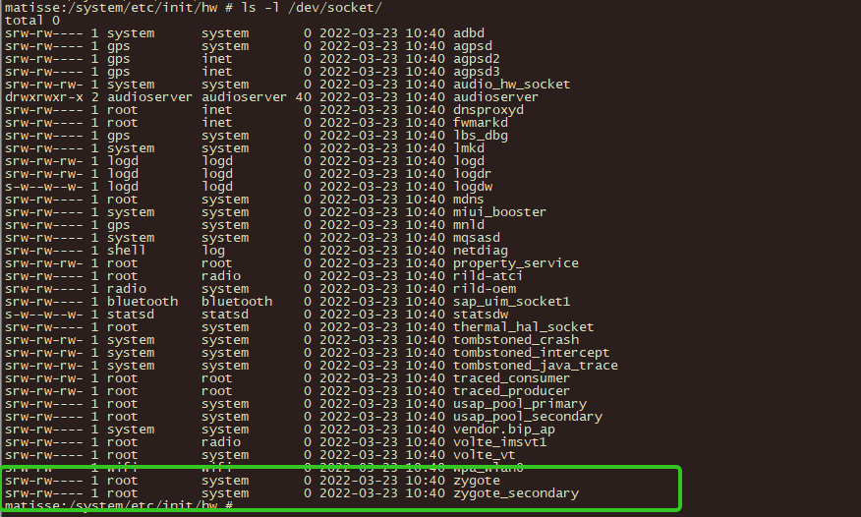
Android开机流程 system_server
system_server
new SystemServer().run();
services/java/com/android/server/SystemServer.java:766: Slog.i(TAG, "Entered the Android system server!");

Slide 39
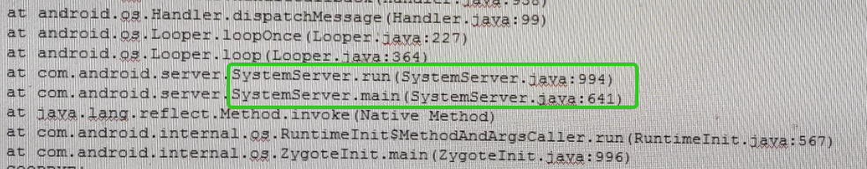
Android开机流程 system_server
system_server
new SystemServer().run();
VMRuntime.getRuntime().clearGrowthLimit();--->large heap
if (Build.IS_DEBUGGABLE) {spawnFdLeakCheckThread
System.loadLibrary("android_servers");
services/java/com/android/server/SystemServer.java:766: Slog.i(TAG, "Entered the Android system server!");
最后sysem_server的main线程进入loop循环，如下堆栈：

Slide 40
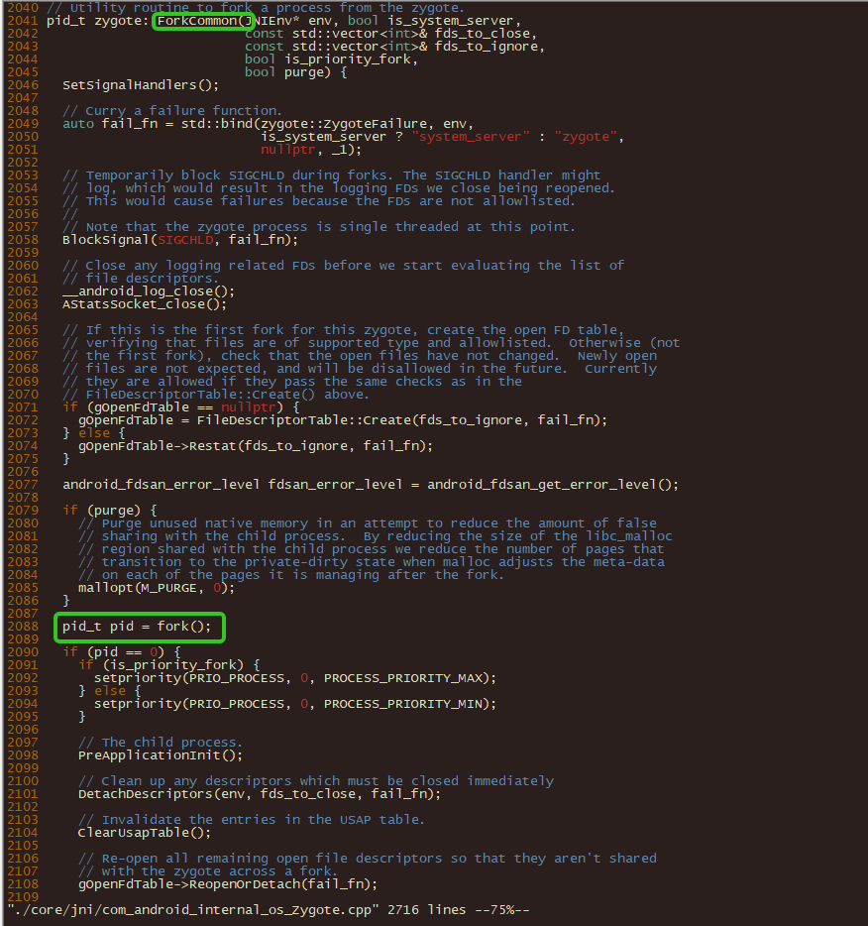
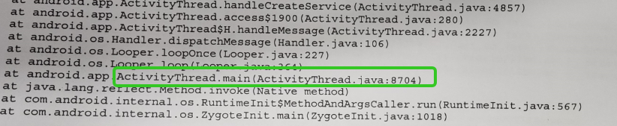
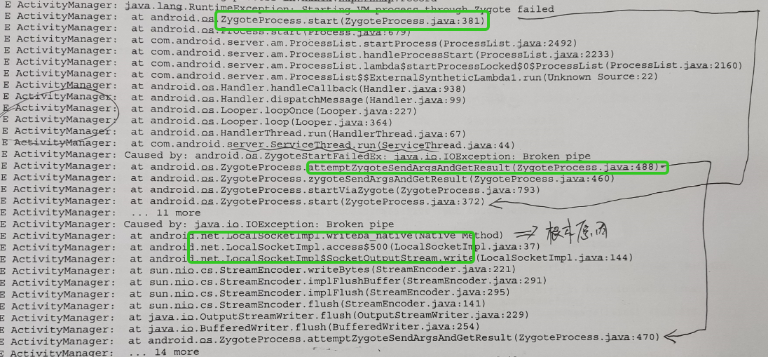
Android开机流程 zygote apk
ActivityThread.main
Looper.loop();

Slide 41
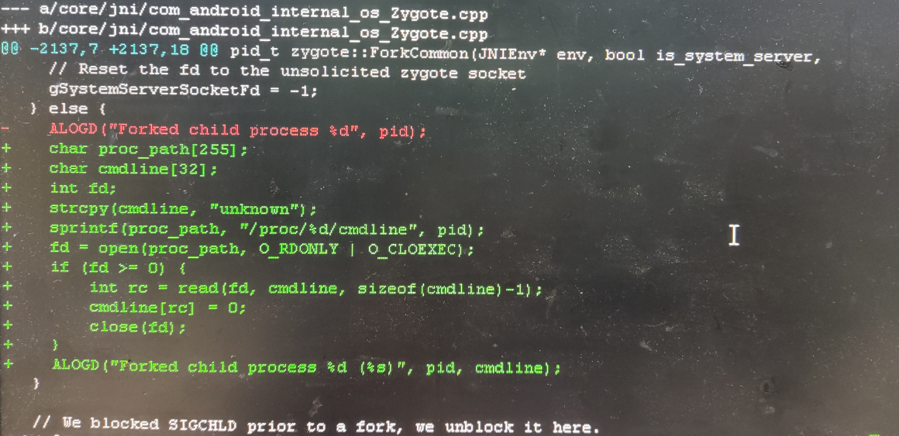
Android开机流程 fork
fork时，apk的名字还是zygote64/zygote
ActivityThread.main
Process.setArgV0("<pre-initialized>");
Looper.loop();
handleBindApplication
Process.setArgV0(data.processName);

Slide 42
Android开机流程 system_server
正常开机
startBootstrapServices
startCoreServices
startOtherServices
安全模式
startOtherServices
final boolean safeMode = wm.detectSafeMode();
mActivityManagerService.systemReady(() -> {
需要system_server开始运行时才会有“安全模式”的检测；
HAPTIC_FEEDBACK_ENABLED，振动效果
LOGO之后开机动画播放前，可以一直按着“音量-”/...

Slide 43
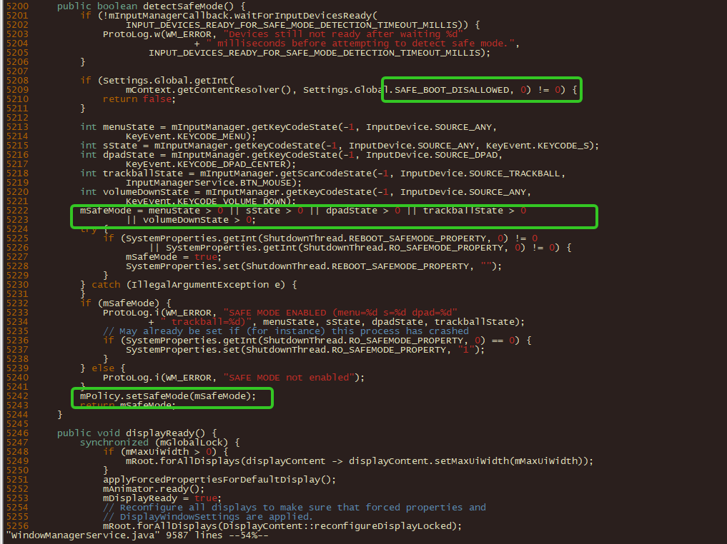
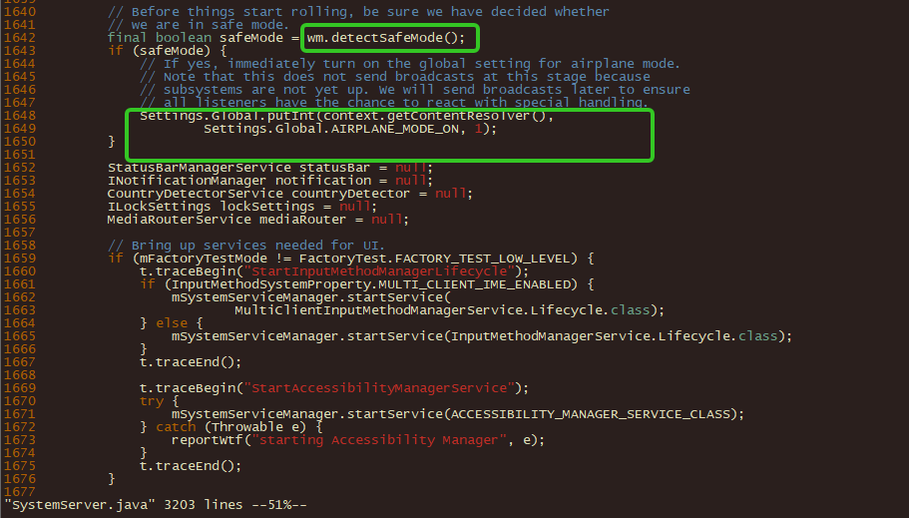
Android开机流程 system_server safemode
安全模式
startOtherServices
第三方APK（不加载/运行）
开启飞行模式

Slide 44
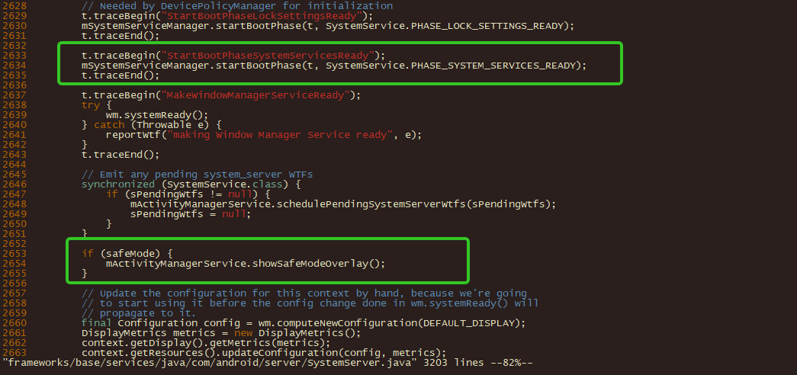
Android开机流程 system_server safemode
mSystemServiceManager.startBootPhase(t, SystemService.PHASE_SYSTEM_SERVICES_READY);
safemode overlay

Slide 45
Android开机流程 system_server Phase
startBootstrapServices
1165 mSystemServiceManager.startBootPhase(t, SystemService.PHASE_WAIT_FOR_DEFAULT_DISPLAY);
startOtherServices
1549 mSystemServiceManager. (t, SystemService.PHASE_WAIT_FOR_SENSOR_SERVICE);
2630 mSystemServiceManager.startBootPhase(t, SystemService.PHASE_LOCK_SETTINGS_READY);
2634 mSystemServiceManager.startBootPhase(t, SystemService.PHASE_SYSTEM_SERVICES_READY);
safemode
2726 mSystemServiceManager.startBootPhase(t, SystemService.PHASE_DEVICE_SPECIFIC_SERVICES_READY);
2762 mActivityManagerService.systemReady(() -> {
2765 mSystemServiceManager.startBootPhase(t, SystemService.PHASE_ACTIVITY_MANAGER_READY);
2910 mSystemServiceManager.startBootPhase(t, SystemService.PHASE_THIRD_PARTY_APPS_CAN_START);
startSystemUi(context, windowManagerF);
ams.finishbooting()
ZYGOTE_PROCESS.bootCompleted(); VMRuntime.bootCompleted();
mSystemServiceManager.startBootPhase(t, SystemService.PHASE_BOOT_COMPLETED);

Slide 46
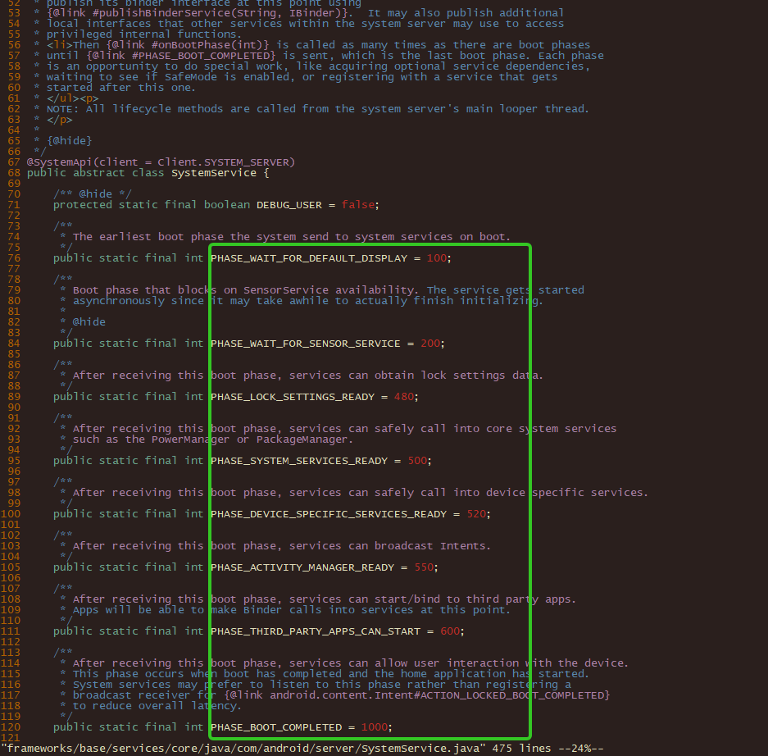
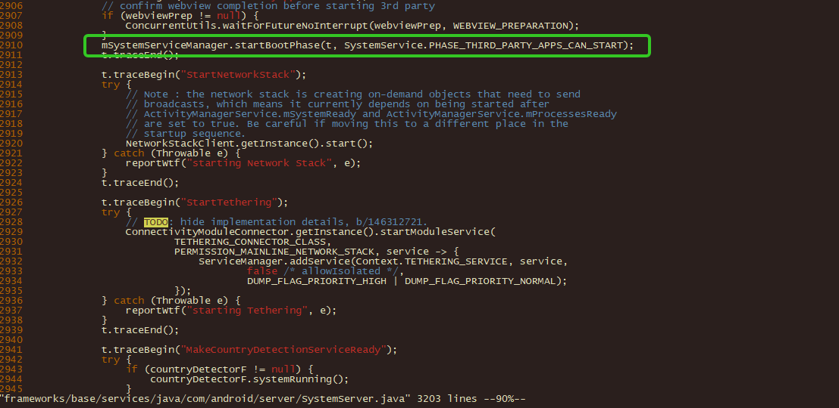
Android开机流程 system_server PHASE
PHASE_BOOT_COMPLETED

Slide 47
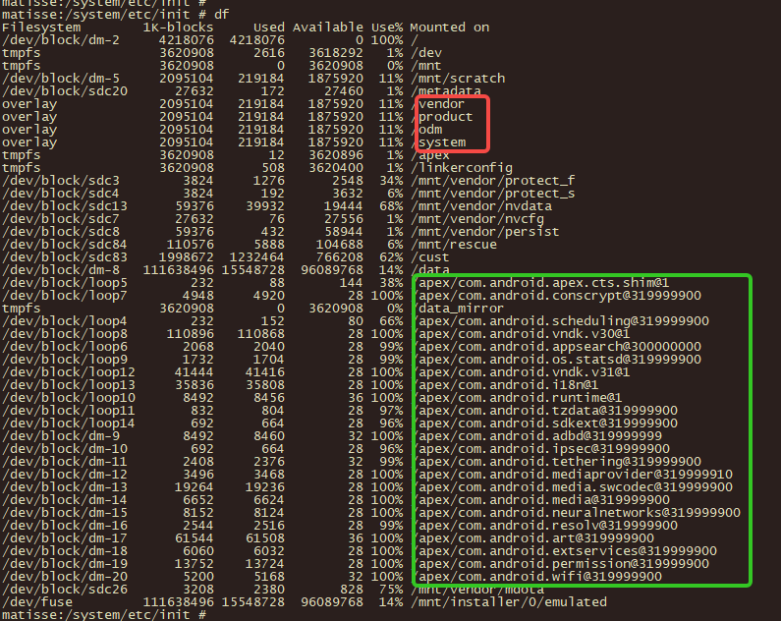
Android开机流程 system_server PMS
在system_server启动前会先mount apex分区
apexd_bootstrap
PMS
传统的APK搜索分区范围
/system/app /system/priv-app
/system_ext
/product
/vendor
/odm
/oem
Android Q开始新增的APEX分区
每一个都是分区镜像ext2 ext4
/apex/*.apex(*.capex)
/system/apex
/system_ext/apex/
...

Slide 48
Android开机流程 system_server AMS
AMS
ActivityThread<---binder--->AMS
mActivityManagerService.systemReady(() -> {
startObservingNativeCrashes
/data/system/ndebugsocket
connectivityF.setAirplaneMode(true);
startPersistentApps(PackageManager.MATCH_DIRECT_BOOT_AWARE);
t.traceBegin("enableHomeActivity");
mAtmInternal.startHomeOnAllDisplays(currentUserId, "systemReady");
t.traceBegin("sendUserStartBroadcast");
t.traceBegin("resumeTopActivities");
bootAnimationComplete -->finishBooting()
Slog.i(TAG, "About to commit checkpoint");
storageManager.commitChanges();
自升级BUG
persist.sys

Slide 49
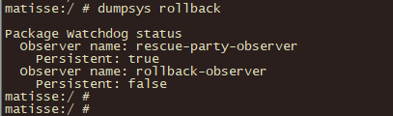
Android开机流程 system_server rollback
Android Q(Android 10)
RollbackManagerService
在PHASE_BOOT_COMPLETED时，将会调用onBootCompleted的函数
scheduleCheckAndMitigateNativeCrashes
FAILURE_REASON_NATIVE_CRASH || FAILURE_REASON_EXPLICIT_HEALTH_CHECK
handleFailureImmediately
currentObserverToNotify.execute
PackageWatchdog.FAILURE_REASON_NATIVE_CRASH:rollbackAll()
mContext.getSystemService(PowerManager.class).reboot("Rollback staged install");
system/core/init/service.cpp
property:
PackageHealthObserver(interface)
RollbackPackageHealthObserver
RescuePartyObserver

Slide 50
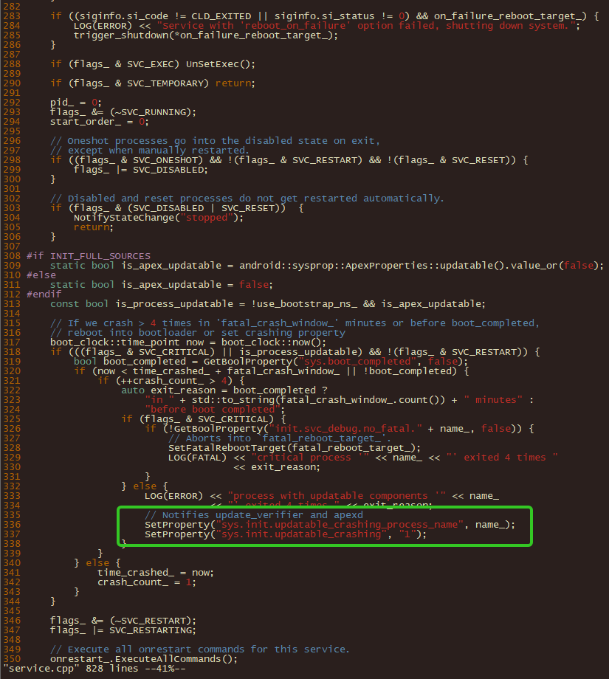
Android开机流程 init/apex/rollback
service.h:169: std::chrono::minutes fatal_crash_window_ = 4min; // fatal() when more than 4 crashes in it
service_parser.cpp:service_->fatal_crash_window_ = *fatal_crash_window;
service.cpp
void Service::Reap(const siginfo_t& siginfo) {
// If we crash > 4 times in 'fatal_crash_window_' minutes or before boot_completed,
316 // reboot into bootloader or set crashing property
sys.init.updatable_crashing_process_name
sys.init.updatable_crshing 1
此处会导致CTS不通过问题，Android原生BUG？
// If we crash > 4 times in 4 minutes or before boot_completed,
sys.boot_completed
CtsRollbackManagerHostTestCases
Device xxx package manager is unresponsive
后续rollback/apex培训，会讲到这块
frameworks/base/services/core/java/com/android/server/rollback/
README.md

Slide 51
Android开机流程 system_server rollback
1. adb install -r -d --enable-rollback --staged ***.apk
2. adb reboot
3. adb shell dumpsys rollback
4. adb root
5. adb shell am crash *** (5 ANRs or process crashes / minute)
6. adb reboot
7. adb wait-for-devices 1 mins

Slide 52
Android开机流程 rollback
system
a/b系统
1、系统的分区设置
传统方式只有一套分区
A/B系统有两套分区，称为slot A和slot B
2、跟bootloader沟通的方式
传统方式bootloader通过读取misc分区信息来决定是进入Android主系统还是Recovery系统
A/B系统的bootloader通过特定的分区信息来决定从slot A还是slot B启动
3、系统的编译过程
传统方式在编译时会生成boot.img和recovery.img分别用于Android主系统和Recovery系统的ramdisk
A/B系统只有boot.img，而不再生成单独的recovery.img
4、OTA更新包的生成方式
A/B系统生成OTA包的工具和命令跟传统方式一样，但是生成内容的格式不一样了
bootcontroll slot a slob b
data
fs checkpoint
apk
RollbackPackageHealthObserver
RescuePartyObserver
ApexManager
StagingManager

Slide 53
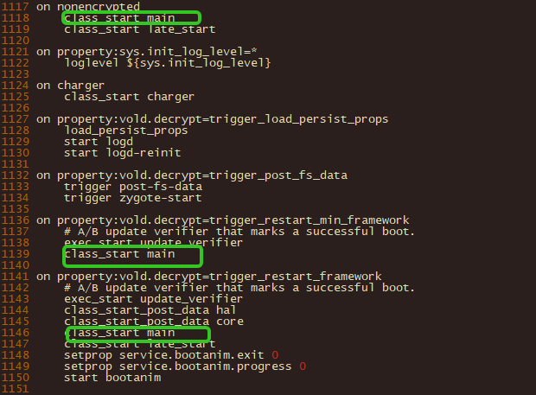
Android开机流程 class_start
class_start core
on boot
vold
servicemanager
bootanimation
lmkd
audioserver
surfaceflinger
class_start main
on encrypt...
installd
storaged
class late_start
llkd

Slide 54
Android开机流程 installd
installd
framework/native/cmd/installd
/data/data/...
user 0/10...
dexopt/dex2oat...
cache tracker
install.java
pms
install.java<----binder/socket----->installd.cpp

Slide 55
Android开机流程 vold
vold
system/vold
meta/fs encrypt
volume manager
apex
StorageManagerService.java
connectStoraged();
connectVold();
mVold.supportsCheckpoint()
sm.java<----binder/socket----->VoldNativeService.cpp

Slide 56
Android开机流程 apexd
apex
system/apex/apexd
mount
loop
PackageManagerService.java
PackageInstallerSession.java
StagingManager.java
ApexManager.java <----binder/socket----->VoldNativeService.cpp
frameworks/base/services/core/java/com/android/server/pm/ApexManager.java
waitForApexService.xxx

Slide 57
Android开机流程 apexd-bootstrap
apexd-bootstrap
[ro.apex.updatable]: [true]
国际版本需要强制开启
system/apex/apexd/
后续apex讲解

Slide 58
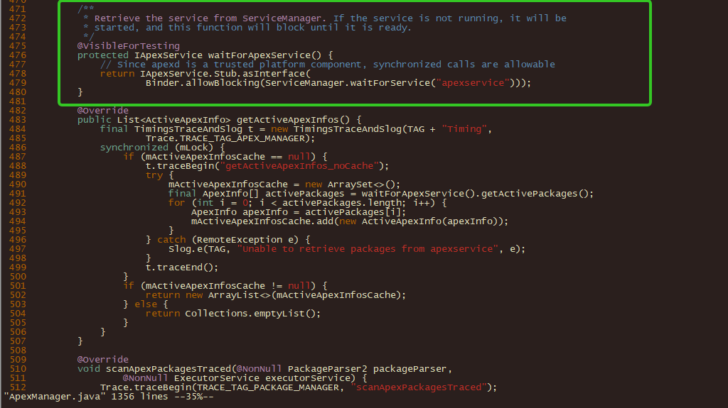
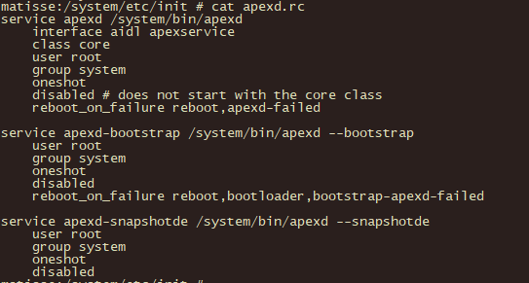
Android开机流程 apexd
class core
oneshot
disabled
root

Slide 59
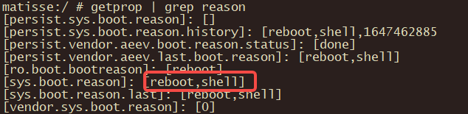
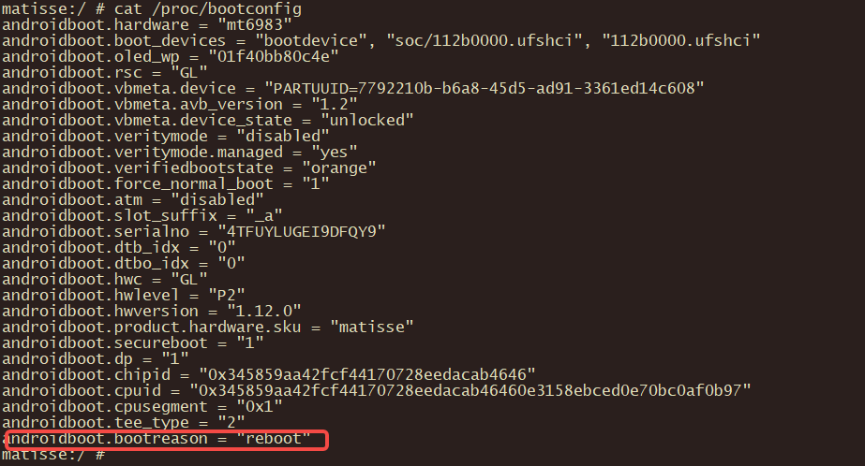
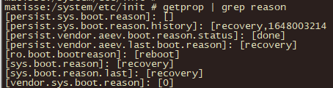
Android开机原因
user
getprop | grep reason
userdebug
cat /proc/bootconfig

Slide 60
Android关机流程
frameworks/base/core/res/res/values/config.xm
<!-- Control the behavior when the user long presses the power button. 0 - Nothing 1 - Global actions menu 2 - Power off (with confirmation) 3 - Power off (without confirmation) 4 - Go to voice assist --> <integer name="config_longPressOnPowerBehavior">1</integer>
frameworks/base/policy/src/com/android/internal/policy/impl/GlobalActions.java
在GlobalActions中有处理onPress()和onLongPress()
一直长按power键关机是在PhoneWindowManager中调用powerLongPress处理
ShutdownActivity.java
动画、界面相关
ShutdownThread.java
frameworks/base/services/core/java/com/android/server/power/ShutdownThread.java
// First send the high-level shut down broadcast.
Intent intent = new Intent(Intent.ACTION_SHUTDOWN);
intent.addFlags(Intent.FLAG_RECEIVER_FOREGROUND | Intent.FLAG_RECEIVER_REGISTERED_ONLY);
ams.shutdown(MAX_BROADCAST_TIME);(10 * 1000)
pms.shutdown();
shutdownRadios
telephonyManager.shutdownAllRadios();
Log.i(TAG, "Performing low-level shutdown...");
PowerManagerService.lowLevelReboot(reason);
SystemProperties.set("sys.powerctl", "reboot," + reason);
PowerManagerService.lowLevelShutdown(reason);
SystemProperties.set("sys.powerctl", "shutdown," + reason);

Slide 61

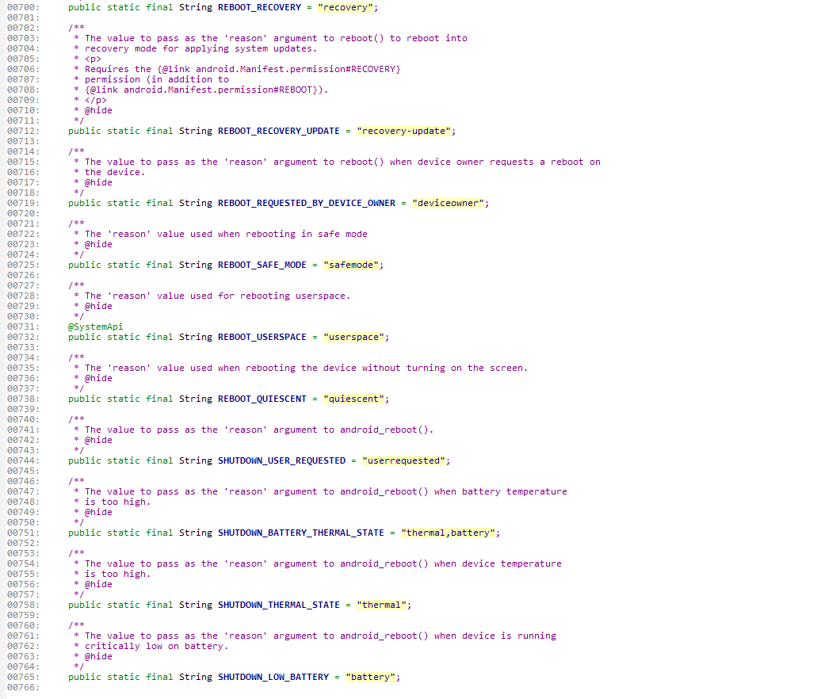

Android 重启/关机流程
powermanager.reboot/shutdown
shutdownthread.reboot/shutdown
lowLevelReboot/lowLevelShutdown
sys.powerctl reboot/shutdown,+reason
注意权限
mContext.enforceCallingOrSelfPermission(android.Manifest.permission.REBOOT, null);
查看原因
sys.boot.reason
[sys.boot.reason]: [reboot,userrequested]
手动按电源键选择重启

Slide 62
Android 重启/关机流程
powermanager.reboot/shutdown
/**
* Reboot the device. Will not return if the reboot is successful.
* <p>
* Requires the {@link android.Manifest.permission#REBOOT} permission.
* </p>
* <p>
* If the {@code reason} string contains ",quiescent", then the screen stays off during reboot
* and is not turned on again until the user triggers the device to wake up (for example,
* by pressing the power key).
* This behavior applies to Android TV devices launched on Android 11 (API level 30) or higher.
* </p>
*
* @param reason code to pass to the kernel (e.g., "recovery") to
* request special boot modes, or null.
* @throws UnsupportedOperationException if userspace reboot was requested on a device that
* doesn't support it.
*/
@RequiresPermission(permission.REBOOT)
public void reboot(@Nullable String reason) {

Slide 63
Android 重启/关机流程
powermanagerservice.reboot/shutdown
/**
* Reboots the device.
*
* @param confirm If true, shows a reboot confirmation dialog.
* @param reason The reason for the reboot, or null if none.
* @param wait If true, this call waits for the reboot to complete and does not return.
*/
@Override // Binder call
public void reboot(boolean confirm, @Nullable String reason, boolean wait) {
RollbackPackageHealthObserver.java
mContext.getSystemService(PowerManager.class).reboot("Rollback staged install");
false
"Rollback staged install"
true

Slide 64

Android关机流程
init通过sys.powerctl属性
通过syscall到kernel

Slide 65
JAVA CRASH
LoggingHandler loggingHandler = new LoggingHandler();
RuntimeHooks.setUncaughtExceptionPreHandler(loggingHandler);
Thread.setDefaultUncaughtExceptionHandler(new KillApplicationHandler(loggingHandler));
LoggingHandler .uncaughtException
Clog_e(TAG, "*** FATAL EXCEPTION IN SYSTEM PROCESS: " + t.getName(), e);
if(mApplicationObject == null && (Process.SYSTEM_UID == Process.myUid()))
FATAL EXCEPTION:
KillApplicationHandler. uncaughtException
// Bring up crash dialog, wait for it to be dismissed
ActivityManager. getService().handleApplicationCrash(mApplicationObject, new ApplicationErrorReport.ParcelableCrashInfo(e));
Process.killProcess(Process.myPid()); System.exit(10);

Slide 66


NATIVE CRASH
/system/core/debuggerd/
adb shell logcat –b crash
crash_dump-->fork-->ptrace-->socket-->tombstoned
g_tombstoned_connected = tombstoned_connect(g_target_thread, &g_tombstoned_socket, &g_output_fd,&g_proto_fd, dump_type);
tombstoned
/data/tombstones/
NativeTombstoneManagerService.java
NativeTombstoneManager
addTombstonedtoDropBox
/datat/system/dropbox

Slide 67


NATIVE CRASH
/system/core/debuggerd/
the sender (linker) and receiver (crash_dump)
bionic/linker
system/core/debuggerd/crash_dump
crasher-->debuggerd_init

Slide 68


NATIVE CRASH
/system/apex/com.android.runtime.apex

Slide 69

NATIVE CRASH
addr2line
nm
objdump...

Slide 70
NATIVE CRASH
file
not stripped/stripped
vmlinux: ELF 64-bit LSB shared object, ARM aarch64, version 1 (SYSV), statically linked, BuildID[sha1]=2d06ce291240ddc18ce602430b46e162dc1a2707, with debug_info, not stripped
elf
so
ko
vmlinux

Slide 71
REBOOT
pm.reboot
adb reboot
adb shell reboot
stop & start
kill system_server/kill surfaceflinger/kill zygote...
echo i > /proc/sysrq-trigger(kill all tasks)
echo b > /proc/sysrq-trigger(reboot)
echo c > /proc/sysrq-trigger(crash)
echo w > /proc/sysrq-trigger(show blocked tasks)
loglevel(0-9) reboot(b) crash(c) terminate-all-tasks(e) memory-full-oom-kill(f) kill-all-tasks(i) thaw-filesystems(j) show-backtrace-all-active-cpus(l) show-memory-usage(m) nice-all-RT-tasks(n) poweroff(o) show-registers(p) show-all-timers(q) sync(s) show-task-states(t) unmount(u) show-blocked-tasks(w) dump-ftrace-buffer(z)

Slide 72
Android REBOOT
stop & start
toolbox
getprop modprobe setprop start stop toolbox
ctl.start/ctl.stop
android::base::SetProperty(start ? "ctl.start" : "ctl.stop", service)
Android reboot
kill system_server
kill surfaceflinger
kill zygote
kill audioserver
kill netd(capabilities CHOWN DAC_OVERRIDE DAC_READ_SEARCH FOWNER IPC_LOCK KILL NET_ADMIN NET_BIND_SERVICE NET_RAW SETUID SETGID)
onrestart restart zygote
onrestart restart zygote_secondary

Slide 73
REBOOT
pidof system_server
pid
getprop | grep reason
[sys.boot.reason]: [reboot,userrequested]
手动电源键选择重启
adb shell logcat –b system
Slog.i(TAG, "Entered the Android system server!");
adb shell logcat –b kernel/adb shell cat /proc/kmsg
高通平台
PMIC ON
最近三次
MTK平台

Slide 74

PANIC
高通/MTK平台工具抓取解析dump
抓取死机dump
获取vmlinux符号表（符号ko）
dmsg中查找panic关键字
找到任务的task号
确认任务的堆栈
继续查找堆栈涉及的相关关键字
用户空间主动触发
llkd
echo c > /proc/sysrq-trigger
echo d
echo w
echo t
system_server何时触发
watchdog.java
调整watchdog的时间
system_server
kernel

Slide 75
Android init Language
/system/core/init/README.md
/system/core/rootdir/init.rc
1. /system/etc/init/ is for core system items
SurfaceFlinger, MediaService, and logd.
2. /vendor/etc/init/ is for SoC vendor items
core SoC functionality.
3. /odm/etc/init/ is for device manufacturer items
motion sensor or other peripheral functionality.

Slide 76
Android Init Language
import *.rc
Actions
on <trigger> [&& <trigger>]*
<command>
<command>
service <name> <pathname> [ <argument> ]*
<option>
<option>
Options
capabilities http://man7.org/linux/man-pages/man7/capabilities.7.html
class <name> [ <name>\* ]
console [<console>]
critical [window=<fatal crash window mins>] [target=<fatal reboot target>]Android开机流程 init/apex/rollback
critical window=${zygote.critical_window.minute:-off} target=zygote-fatal
disabled
oneshot
onrestart
socket <name> <type> <perm> [ <user> [ <group> [ <seclabel> ] ] ]
updatable

Slide 77
Android Init Language
Triggers
mkdir chown chmod write exec mount_all mount restart restorecon
rmdir rm setprop start stop
trigger umount unmount_all
readahead
exec_background(同exec区别)

Slide 78

Android Init Language
parser map
static init

Slide 79
回顾
开机流程
pbl/sbl(qcom)
bootloader
kernel
init
system_server
关机流程
shutdownthread

Slide 80

Q&A

